Slide 1
DJIA Stock Prediction
Developed By: Khanh Ho

Slide 2
The Problem
Stocks are subject to supply, demand and patterns of human behavior
Can we use technical analysis to determine future close prices?

Slide 3
Technical analysis and REGRESSION Models
Feature Engineering includes:
Previous Day’s Closing Price
Rolling Average of Closing Prices and Volume
Standard Deviation of Volume and Ratio of Volume Rolling Averages
Return ratios and previous day return ratios
Regression Methods
Stochastic Gradient Descent
Random Forest
Support Vector
Neural Network

Slide 4
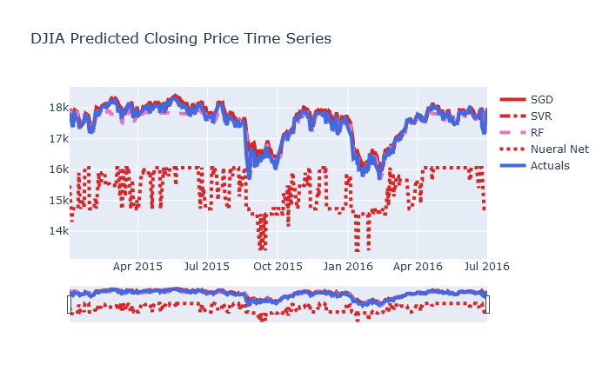
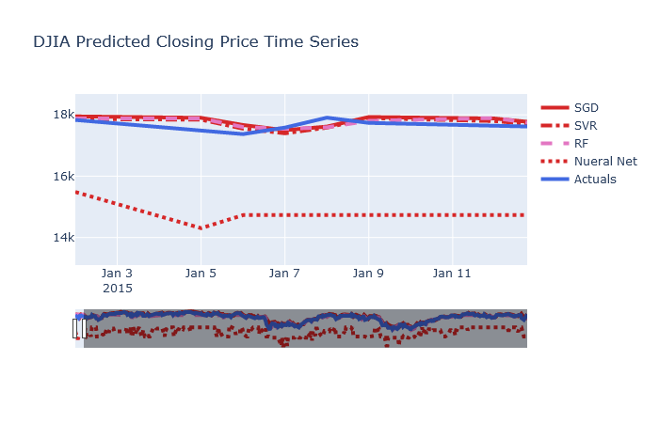
Model output
4 regression models
Entire forecast on the left slide and 5 day forecast on the right slide

Slide 5
Model Evaluation by error scoring
Best model scores are highlighted in green
The errors are significant enough to make the models challening for investing
Model trend prediction is however very good

